Slide 1
DEVI AHILYA VISHWAVIDYALAYA
CENTRAL LIBRARY
RESOURCES and SERVICES

Slide 2
Salient Features
Strong Functional Compatibility with the University Teaching Departments
Trend setter Library in Central India with ICTELS
Functions in a fully decentralized model with River and
tributaries structure
Library services fulfill “ Five Laws of Library Science”
Outstanding usage of Electronic Journals
Good Functional Compatibility with diversified users

Slide 3
RESOURCES
NON PRINT
Audio cassettes,
Book collection,
Thesis
Braille collection,
Expert Lecture s in PPTS, Faculty Research Papers
Periodicals
PRINT
Electronic resources, E-Journals, E-Books

Slide 4
COLLECTION
To cater to the information needs of the members the Central Library is building its collection judiciously .
The collection is balanced for all subjects, with emphasis on the subjects of UTDs
Presently the Central Library has a total collection of 2,24,911 Volumes of reading materials.

Slide 5
THESIS COLLECTION
Ph.D Thesis 3893
M.Phil Dissert. 1890
M.A.Dissert. 18157
Total: 23940

Slide 7
ELECTRONIC Journals
University is part of UGC INFONET program and 10391 scientific journals are accessible electronically on 24 X 7 hours
http://www. http://www.dauniv.ac.in/ugcinfonet.php
http://www.dauniv.ac.in/ugcinfonet.php

Slide 8
ELECTRONIC RESOURCES : Contd..
To supplement INFONET journals, the university is subscribing to electronic resources (through INDEST):
Institute of Electrical and Electronics Engineers(IEL) online
Association for Computing Machinery(ACM) Digital Library
Emerald Extra(Management Sc. Journals)
EBSCO Business Source premier
Indiastat. Com(Database)
E-Books

Slide 9
ELECTRONIC LECTURES
The lectured developed by the Faculty of IITs and IISc under NPTEL (1232 Video Lectures) are linked to the library website.
http://nptel.ac.in/

Slide 10
Institutional Knowledge Resources
Institutional Knowledge Resources (Faculty Publications, Expert Lecture Notes in PPTS) are being developed in digital form
Link:
http://
10.0.10.155:8080/digit-resours.htm

Slide 11
BASIC SERVICES
Library is open for 10 hours on all working days and for 7 hours on holidays.
Home lending of books
Inter Library Loan
University Library Catalogue on intranet.

Slide 12
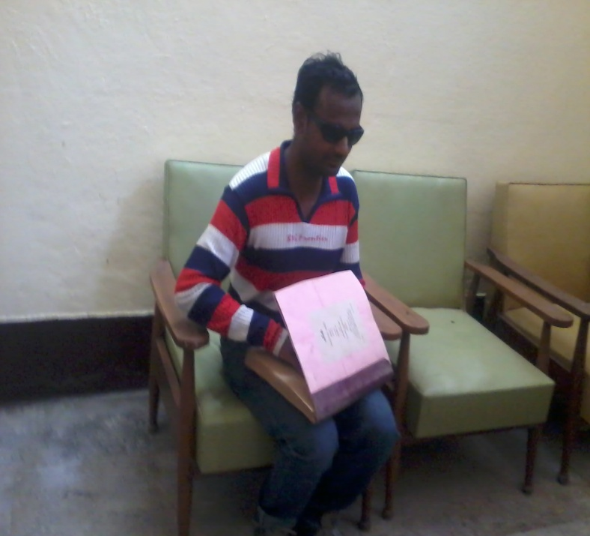
Differently Enabled Friendly Library Services
Special collection for the Differently Enabled users with 600 +Volumes of Braille Books and 219 Audio CDs.
Separate women rest room

Slide 13
ICT Enabled Library Services
Computerized issue/return of books
Web OPAC of the University Central Library and Department Libraries is available on intranet.
Participation in Shodhganga project with INFLIBNET
http://10.0.10.132/webopac/

Slide 14
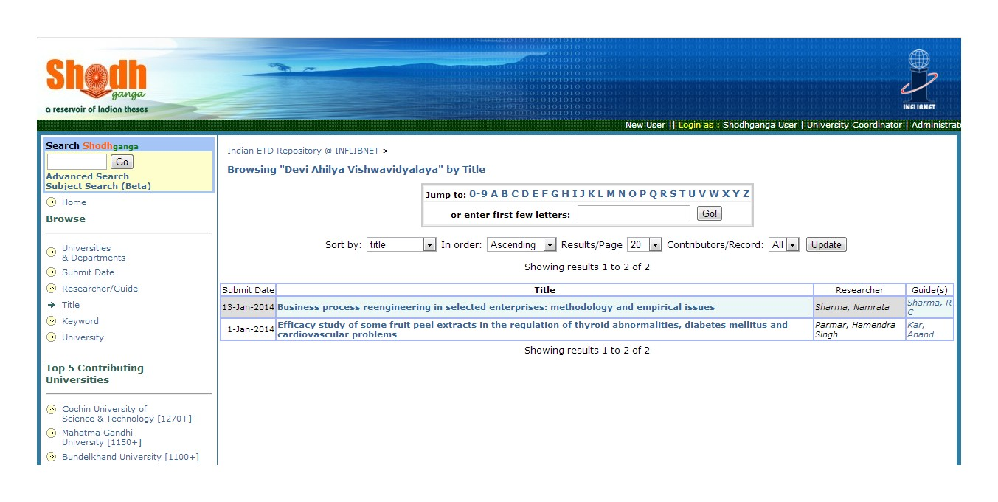
Participation in Shodhganga Project

Slide 15
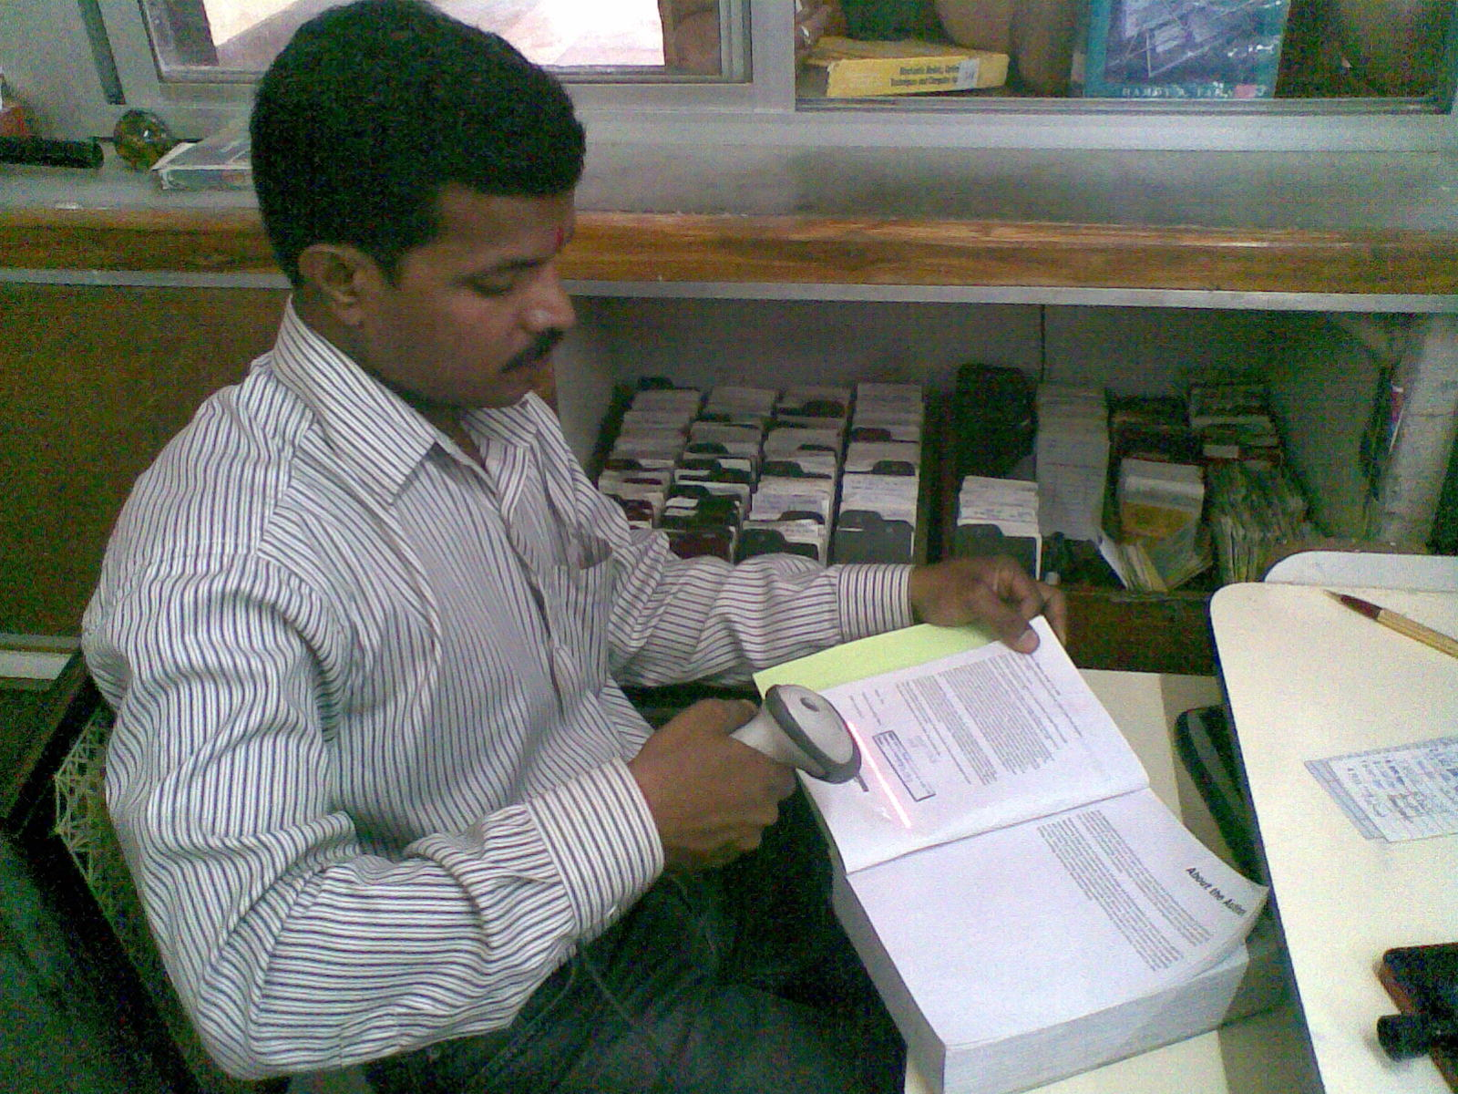
COMPUTERIZED ISSUE/RETURN
All the books available in the university central library have been bar coded.

Slide 16
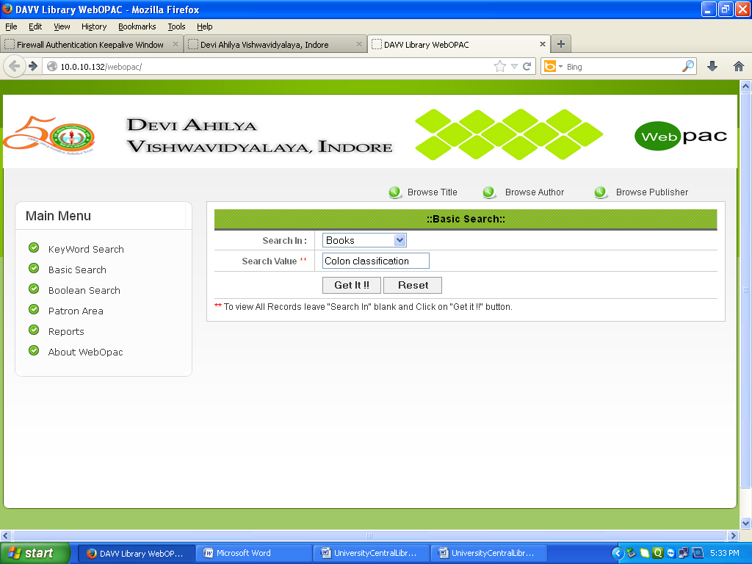
UNION CATALOGUE OF BOOKS
The Library Catalogue of the Departmental Libraries is available on intranet.
The Library database has 1,99,437 records of books and other reading material.

Slide 17
ELECTRONIC SECURITY
Books are under Electronic Article Surveillance system with RF chips pasted.

Slide 18
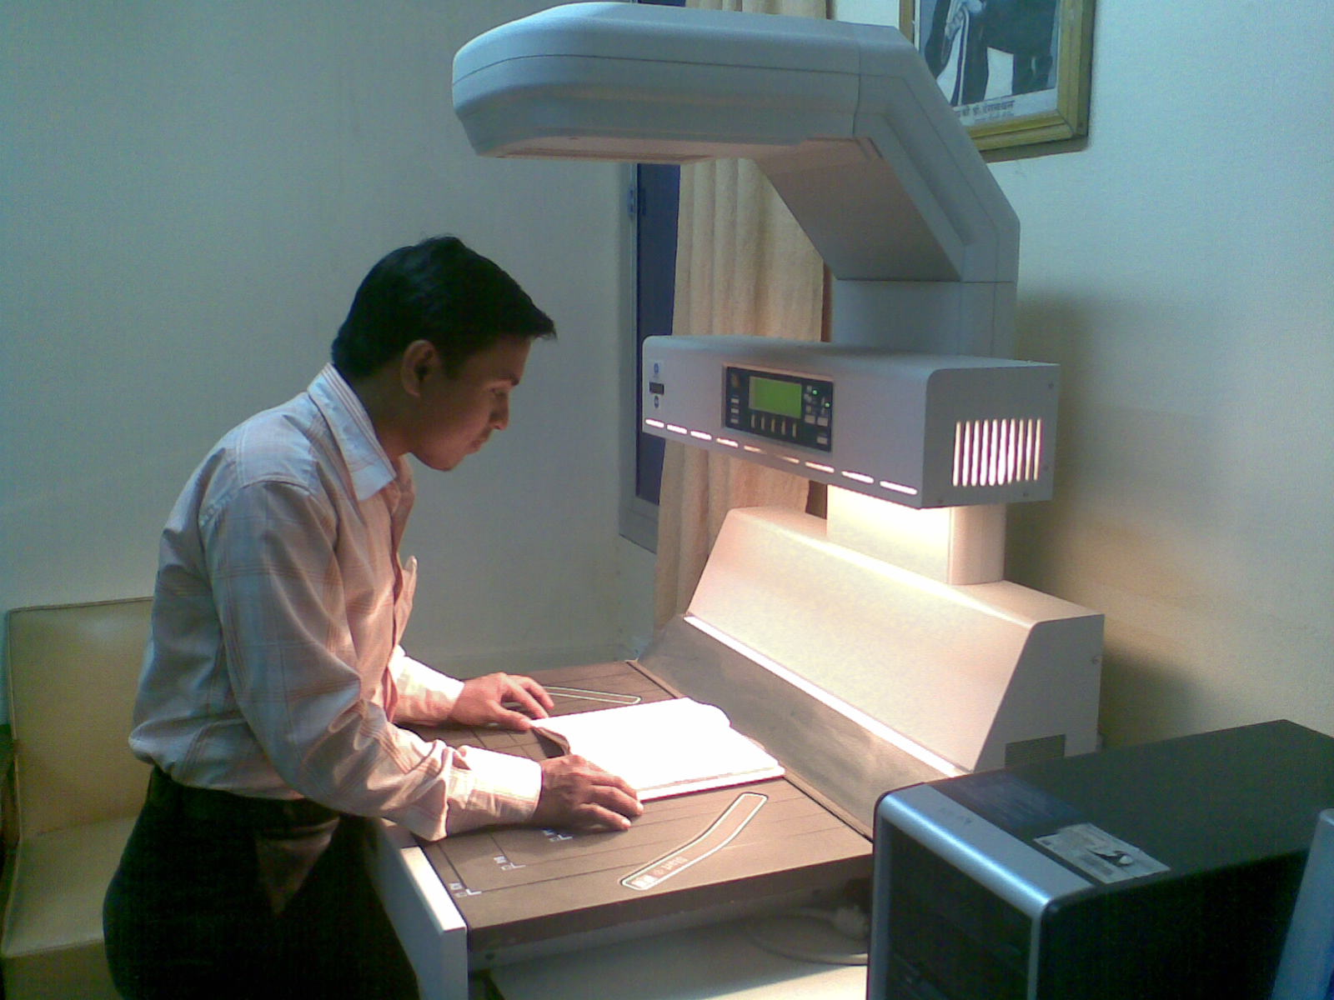
DIGITIZATION OF DISERTATIONS
For uploading the Ph. D. Dissertations, submitted before 2013, the university purchased a book scanner

Slide 19
POWER BACKUP IN THE LIBRARY
For Providing uninterrupted Services for the students, UPS has been purchased and used in the stack hall and reading room.

Slide 20
Total Library collection as on 01.01.2014
Particulars | Number
Total Book Collection | 183105
Bound Volumes of Periodicals | 13254
Thesis | 23940
Audio-Visual Materials | 3000
Braille Books | 800
Total | 224099

Slide 21
Subject wise Collection of Books (as on 01.01.2014)
SUBJECT WISE COLLECTION OF BOOKS
AS ON 01.01.2014
Subject | Vols.
Arts, Humanities and Literature | 38070
Social Sciences | 30921
Commerce | 4880
Sciences | 23338
Management | 11350
Computer Science and Electronics | 20457
History and Geography | 13569
Engineering and related Subject | 3753
Pharmacy | 2795
Reference books | 17129
Total: | 166262

Slide 22
LIBRARY INCOME

Slide 23
EXP.ON BOOKS AND OTHER ITEMS
Expenditure
Year | Reading material | Other than books | Total
2012-13 | 1609184 | 10688583 | 12297767
2011-12 | 2267968 | 6022645 | 8290613
2010-11 | 1102617 | 5191000 | 6293617
2009-10 | 2366819 | 3212497 | 5579316
2008-09 | 3178064 | 2518465 | 5696529
Total: | 10524652 | 27633190 | 38157842

Slide 24
AMOUNT SPENT ON THE DEVELOPMENT OF THE LIBRARY

Slide 25
UGC XIth Plan Grant Utilized during 2008-09 to 2012-13

Slide 26
Amount Spent for E-Journals

Slide 27
E-Journals Available through INFONET Program
Resource Name No. Journals
American Chemical Society 37
American Institute of Physics 18
American Physical Society 10
Annual Reviews 33
Cambridge University press 224
Economic and political weekly 1
Institute of Physics ` 46
Jgateplus 10000
Jstor 2585
Mathscinet 1
Oxford University Press 206
Portland Press 19
Project Euclid 35
Project Muse 493
Royal Society of Chemistry 35
Science Direct 1036
SIAM 14
Springer Journals 1763
Taylor & Francis 1079
Web of Science 1

Slide 28
E-Journals Usage during 2009-2012

Slide 29
Usage Statistics of E-Journals

Slide 30
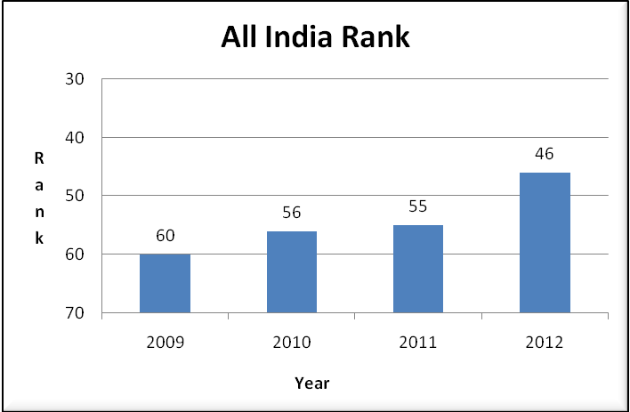
All India Rank(Based on total Downloads of Full Text Research papers)

Slide 31
Reading Materials Added(CL and DL’s)(2008-2013)
44709 Books were added in the Central Library and Department Libraries, by spending an amount of Rs.219.27 Lakhs.

Slide 32
Number of Books Purchased during 2008-2013

Slide 33
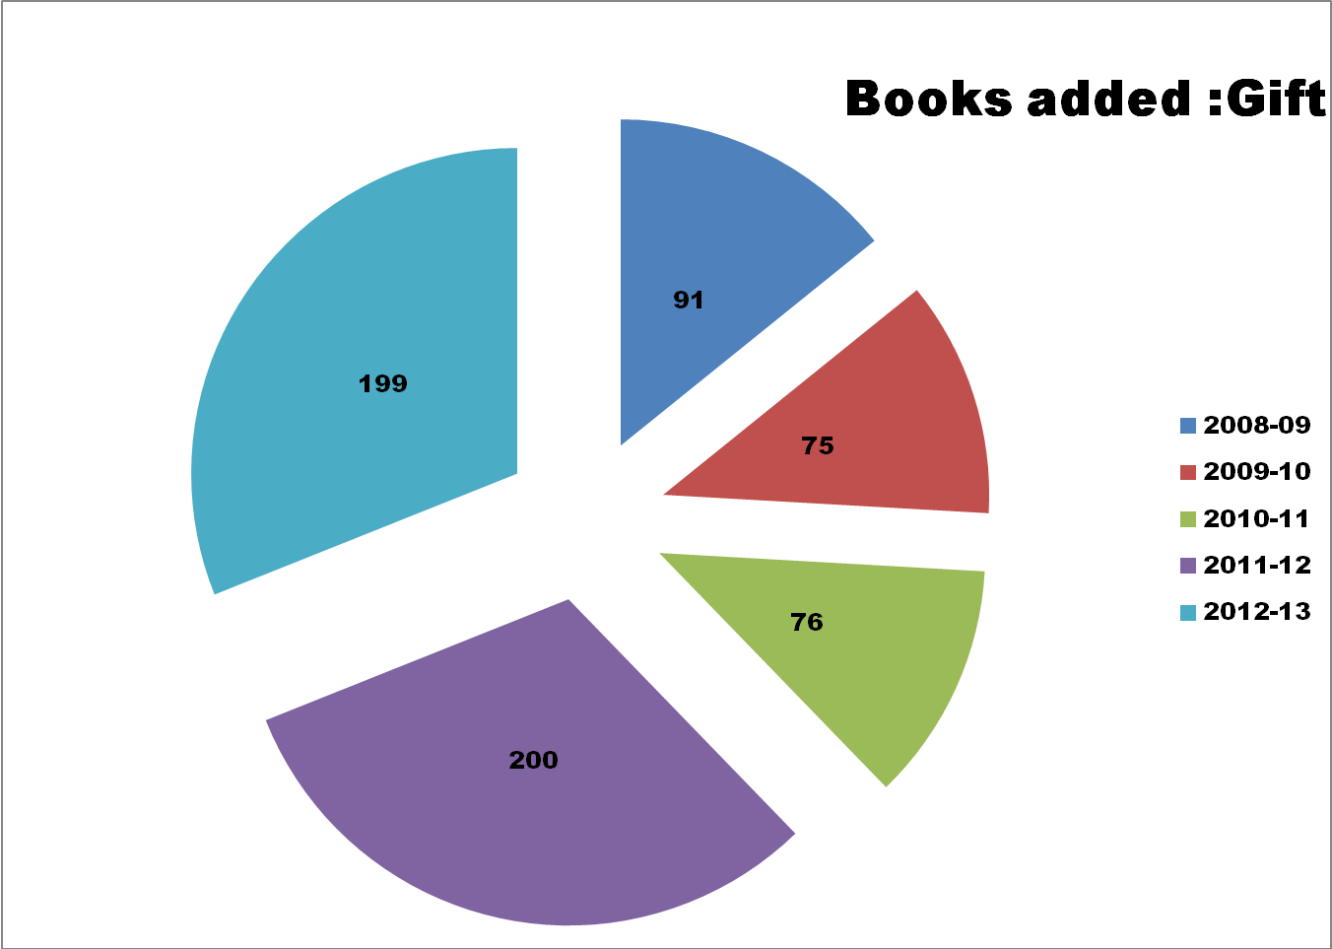
Book Added: Gift

Slide 34
Thesis Added

Slide 35
Subject Wise Number of E-Books(In Process)
An amount of Rs. 21,60,302.00 has been allotted for the purchase of 319 E-Books during the Year 2013-14.

Slide 36
LIBRARY MEMBERSHIP DURING 2008-2013
The Central Library and the Department Libraries cater to more than10,500 students, Research Scholars, Faculty and other members.

Slide 37
LIBRARY VISITORS

Slide 38
Number of Days Library Open

Slide 39
Library Membership During 2012-13

Slide 40
Gender Wise Users in 2012-13

Slide 41
Library Visitors During 2012-13

Slide 42
Books and Other Reading Material Added in 2012-13

Slide 43
Books Issued During 2012-13

Slide 44
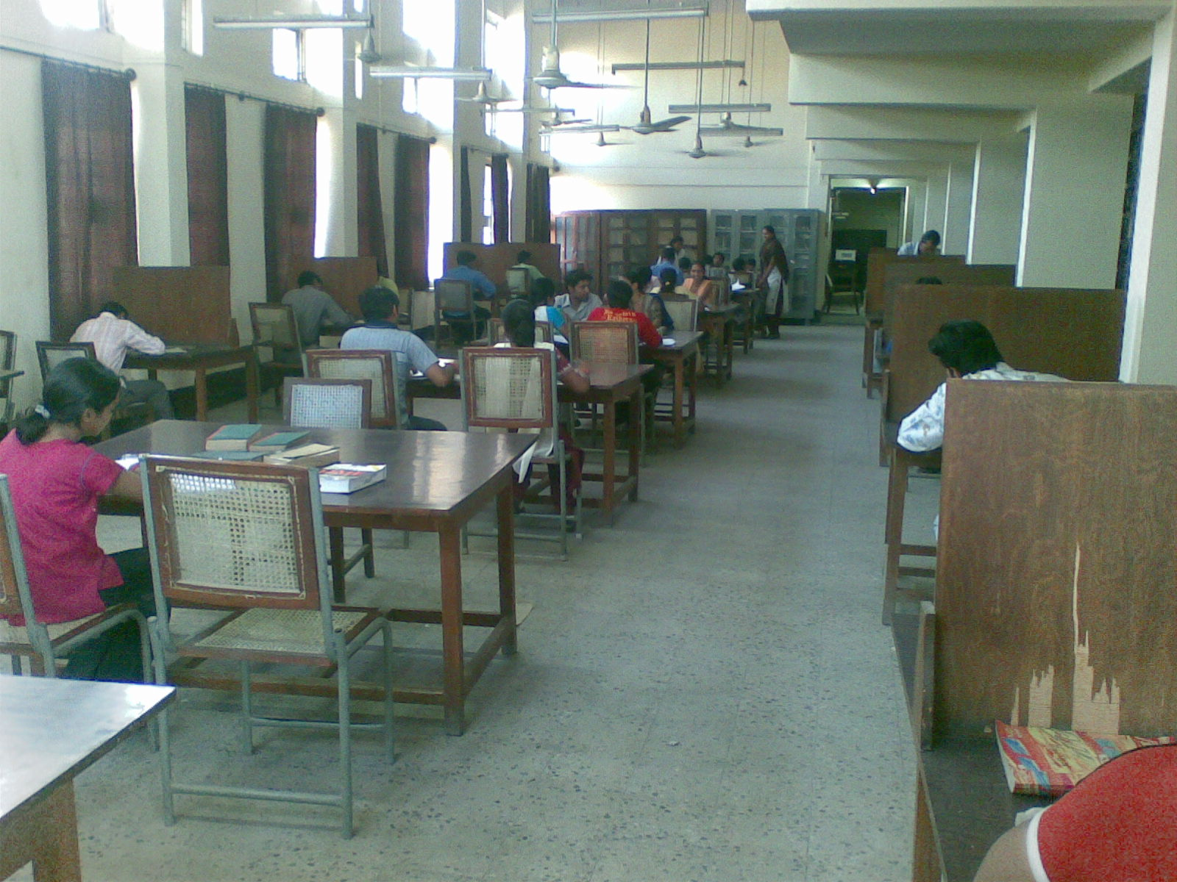
READING ROOM

Slide 45
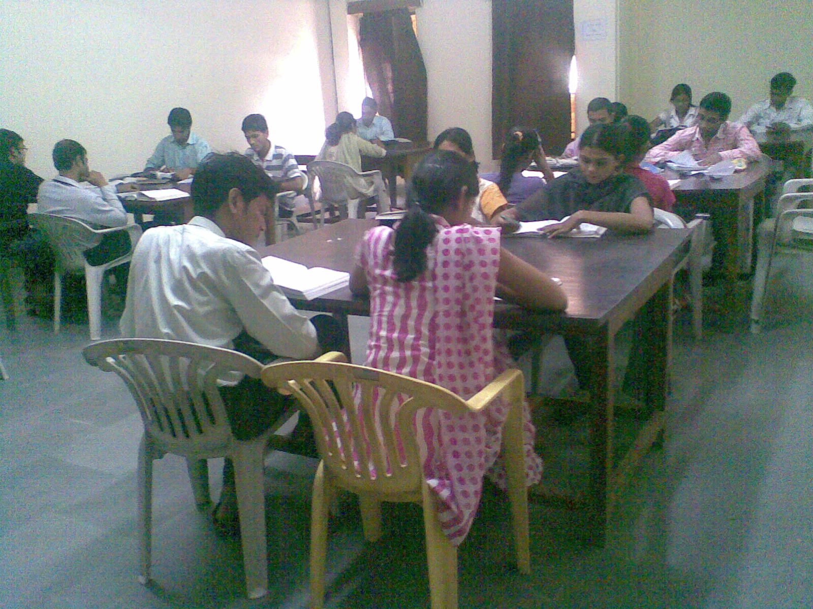
PERSONAL BOOK READING HALL

Slide 46
LIBRARY STAFF
Posts Sanctioned Working Vacant
Professional: 18 07 11
Non Prof. 11 08 03
Office staff 05 01 04
Watch & Ward 11 06 05
Contingency 06 06 --
Total: 51 27 24

Slide 47
BEST PRACTICES:
Differently Enabled User Friendly Library Services
Institutional Knowledge Resources are available on the Library website:
University Library is the laboratory for Library science students for their practice.
http://10.0.10.155:8080/digit-resours.htm

Slide 48
FUTURE PLANS
Separate Digital Library with 100 systems for the use of the members .
Subscriptions to digital collections on emerging areas.
Systematic sharing of the library resources among the members of university library system.
Introducing Web 2.0 services
Introducing Electronic article surviellanance system in the Department libraries.

Slide 49
THANKS FOR THE VISIT

